Slide 1

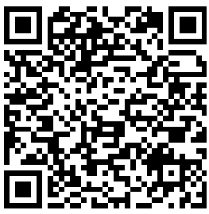

Creating a better service for a better future.
Queensland Children’s Hospital would like to understand gut health of all Queensland children aged 12-18 years old.
If you wish to contribute, we kindly invite you to complete
an anonymous 20-minute survey, by scanning the
QR code below.
Information Sheet
Survey Link
The best care for every Queensland child
Version 2.0 20-05-25

